Slide 1

Customer Churn Prediction using AWS
DATA650 Project
Team:
Swathi Baskaran
Sivani Dronamraju
Ayushi Prasad
Sinchana Gupta
Jacqueline Yu

Slide 2

Project Overview
Customer churn prediction is critical for improving customer retention and business profitability.
We use machine learning models to analyze customer behavior and predict churn risk.
The project leverages AWS services for data processing, model training, prediction and visualization.

Slide 3

Problem Statement
Businesses lose revenue due to customer churn.
Identify at-risk customers for proactive customer retention strategies.
Identifying churn triggers for proactive customer retention strategies.
Visualize customer journeys to identify critical touchpoints.

Slide 4

Proposed Solution
Use historical customer data to train ML models. Experiment with 4-5 models.
Identify churn triggers and predict at-risk customers.
Send notification about at risk customers.
Visualize customer journeys and churn patterns using dashboards.
Actionable insights to improve customer retention.

Slide 5

Dataset Overview
Churn_Modelling.csv from Kaggle
14 columns - CreditScore, Geography, Gender, Age, IsActiveMember, Exited, etc
Geography
France, Spain, Germany
10,000 datapoints
Source:
https://www.kaggle.com/datasets/shrutimechlearn/churn-modelling

Slide 6

Tools and Technologies
AWS Services:
AWS IAM: User and role creation for access control.
AWS S3: Data storage and management.
AWS SageMaker: Data cleaning, preprocessing, model training and deployment.
AWS QuickSight: Data visualization and dashboarding.
AWS SNS: Event driven notifications.
AWS Lambda Function: Automating custom emails.
AWS SES: Configure recipients and delivery emails.
Other Tools: Jupyter Notebook.

Slide 7
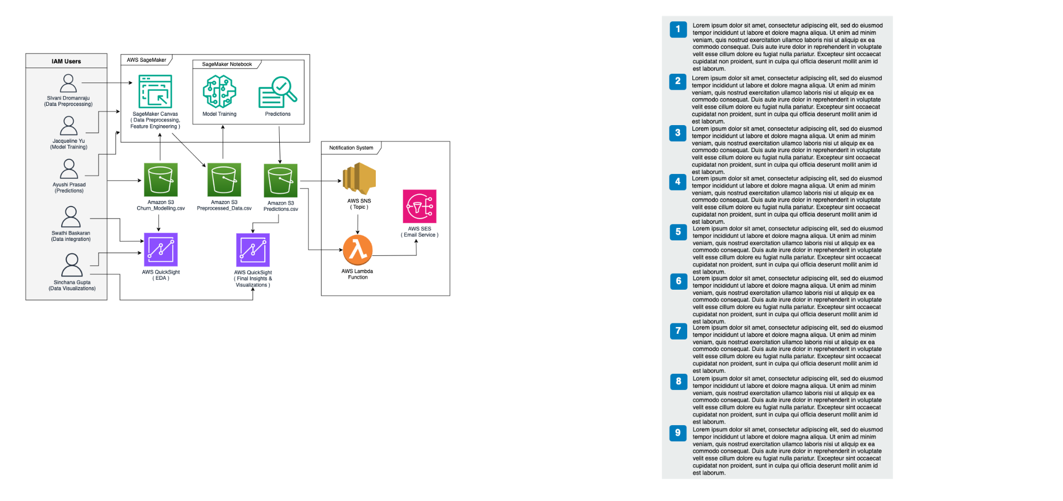
Architecture Overview

Slide 8

AWS Identity and Access Management (IAM)
For secure access management
Created 5 IAM Users
Roles Assigned:
Swathi Baskaran: Data Engineer
Sivani Dronamraju: Manager/Data Scientist
Ayushi Prasad: ML Engineer
Sinchana Gupta: Data Analyst
Jacqueline Yu: ML Engineer
Created 1 IAM Group to manage shared permissions.

Slide 9

IAM Permissions
Role-Based Policies:
Granted permissions through predefined IAM policies tailored to specific tasks and responsibilities.
Custom Inline Policies:
Designed inline (custom) policies to address unique requirements for certain roles.
Example: Special permissions for accessing specific AWS services like SageMaker, Glue, and QuickSight.

Slide 10
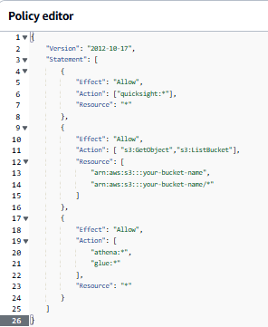
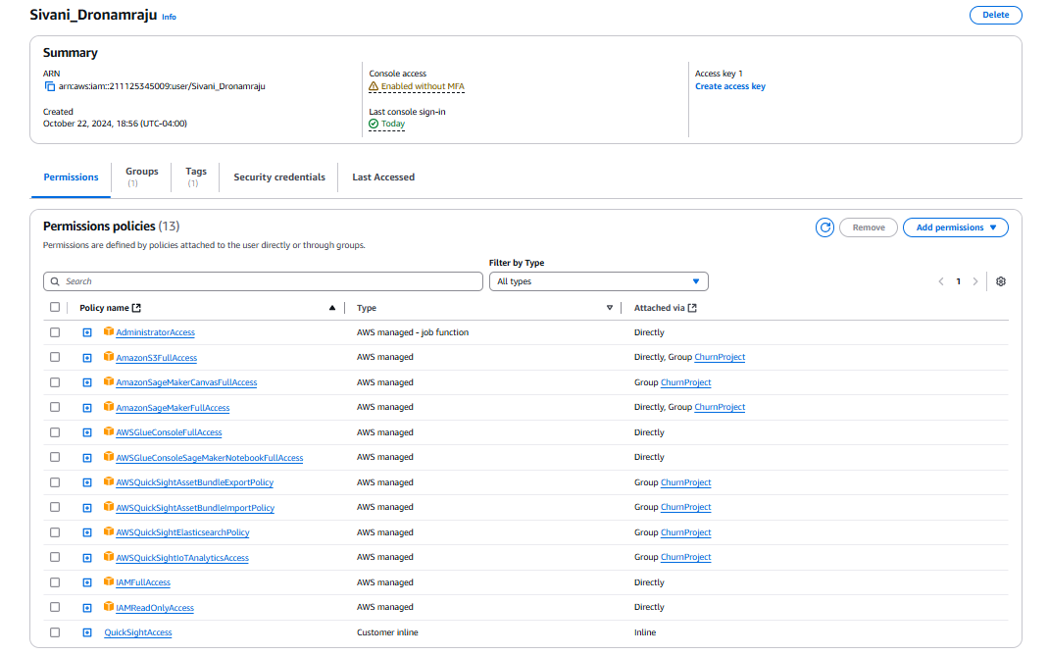
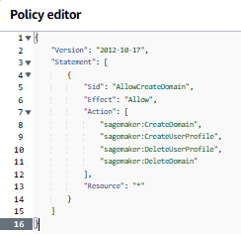
Inline policies:
Permissions:

Slide 11
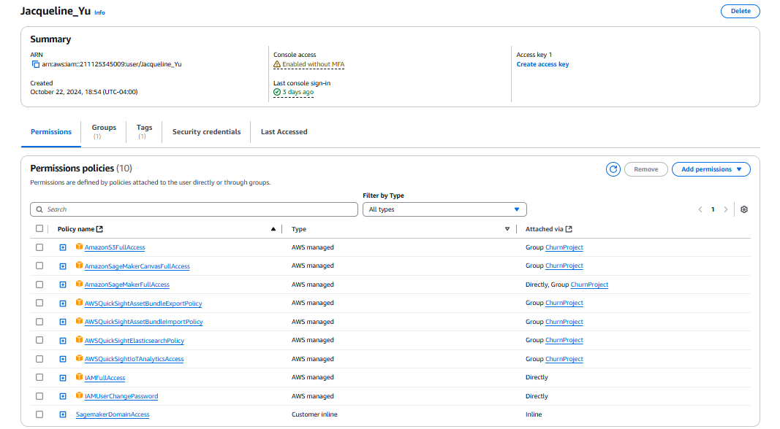
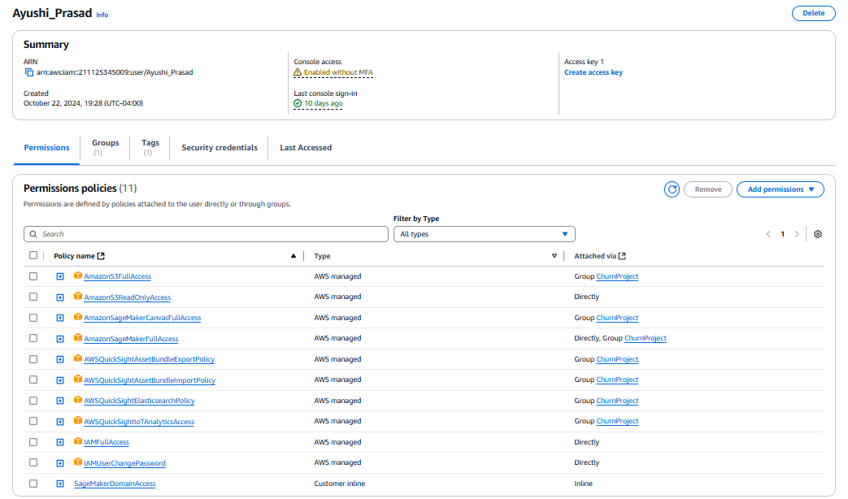
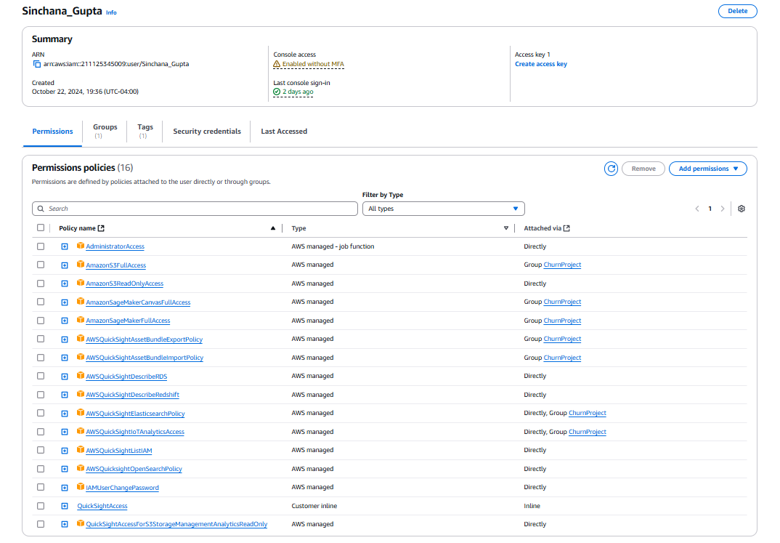
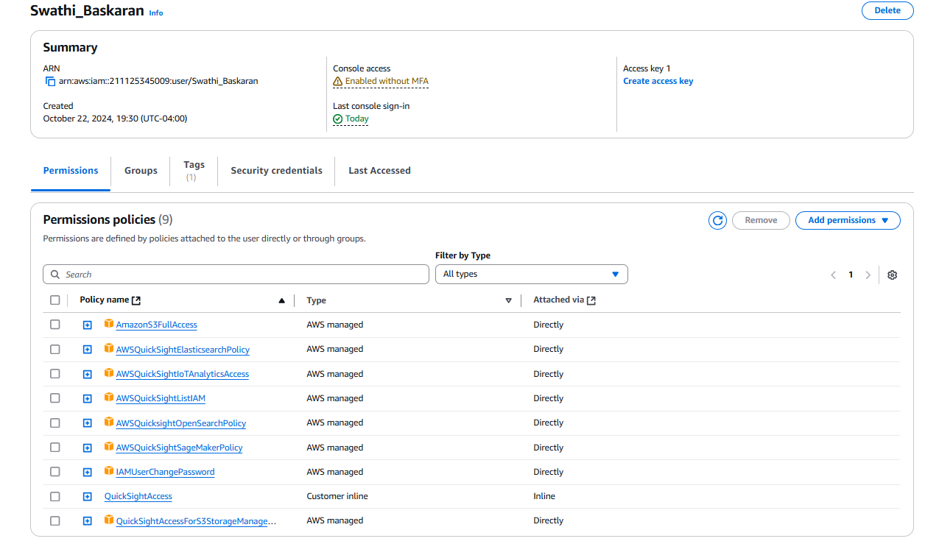

Slide 12

Data Storage - AWS S3
S3 Bucket Creation:
A dedicated S3 bucket named churn-modelling-bucket was created.
Dataset Upload:
Uploaded the churn_modelling.csv dataset
Integration with Other Services:
AWS S3 serves as the central storage, enabling:
Feature storage for AWS SageMaker.
Access to processed data for AWS QuickSight dashboards.

Slide 13
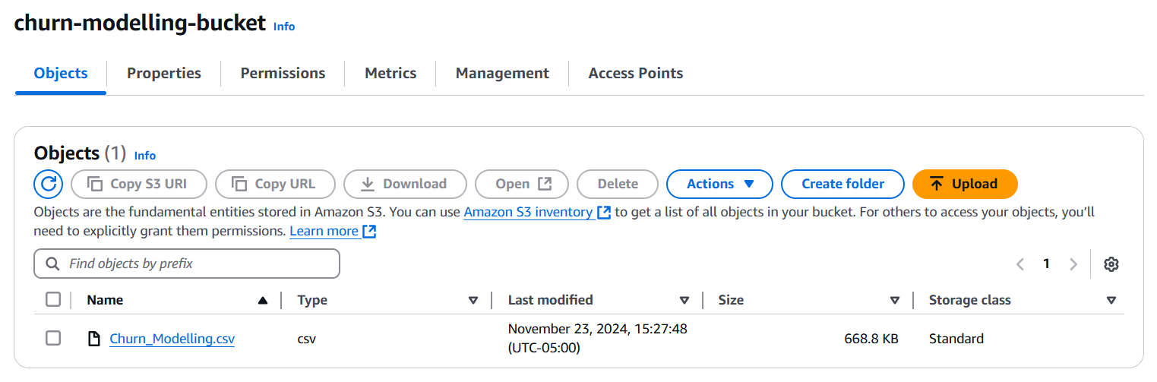
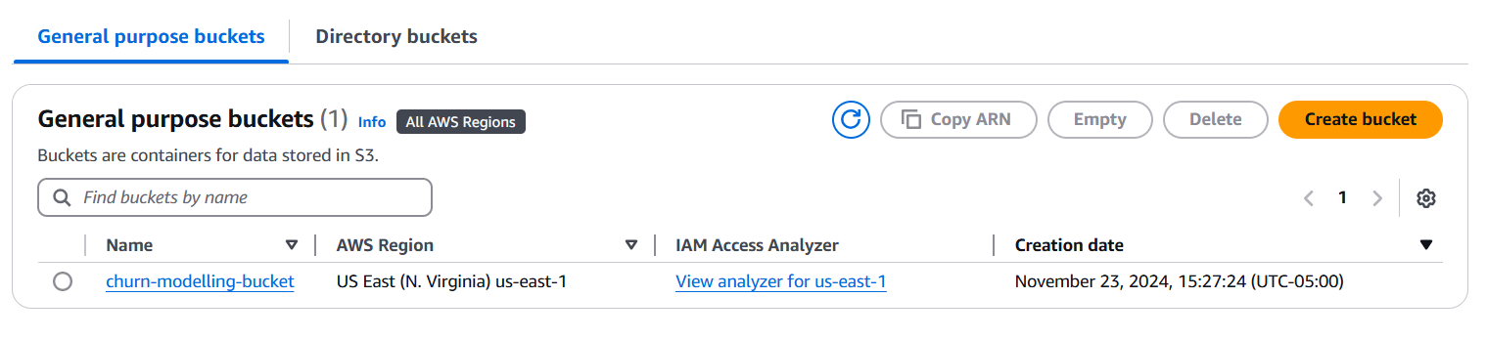

Slide 14

EDA - AWS QuickSight
Used the churn_modelling.csv and created a manifest.json file.
Exploratory Data Analysis (EDA):
Univariate Analysis: Explored individual features to understand their distributions.
Bivariate Analysis: Investigated relationships between features.
Key insights:
Age: Majority of customers fall between 30-40 years.
Balance: Many customers have a balance close to zero.
Higher churn observed among customers with fewer products.
Churn rates differ by geography and gender.
Credit score has a weak correlation with churn.

Slide 15
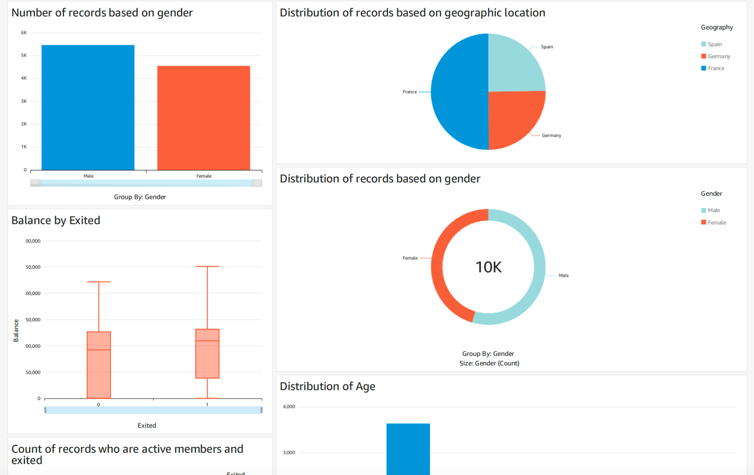

Slide 16
Data Preprocessing - AWS SageMaker
Domain Creation: Set up a SageMaker domain to facilitate data preprocessing and feature engineering tasks.
Data Import: Imported churn_modelling.csv dataset from S3 -> SageMaker Canvas.
Encoding Categorical Variables: Converted non-numeric data into machine-readable formats.
Feature Engineering: Created new meaningful features from the raw data
Data Export for Model Development: The preprocessed dataset, including engineered features, was exported back to the S3 bucket.

Slide 17
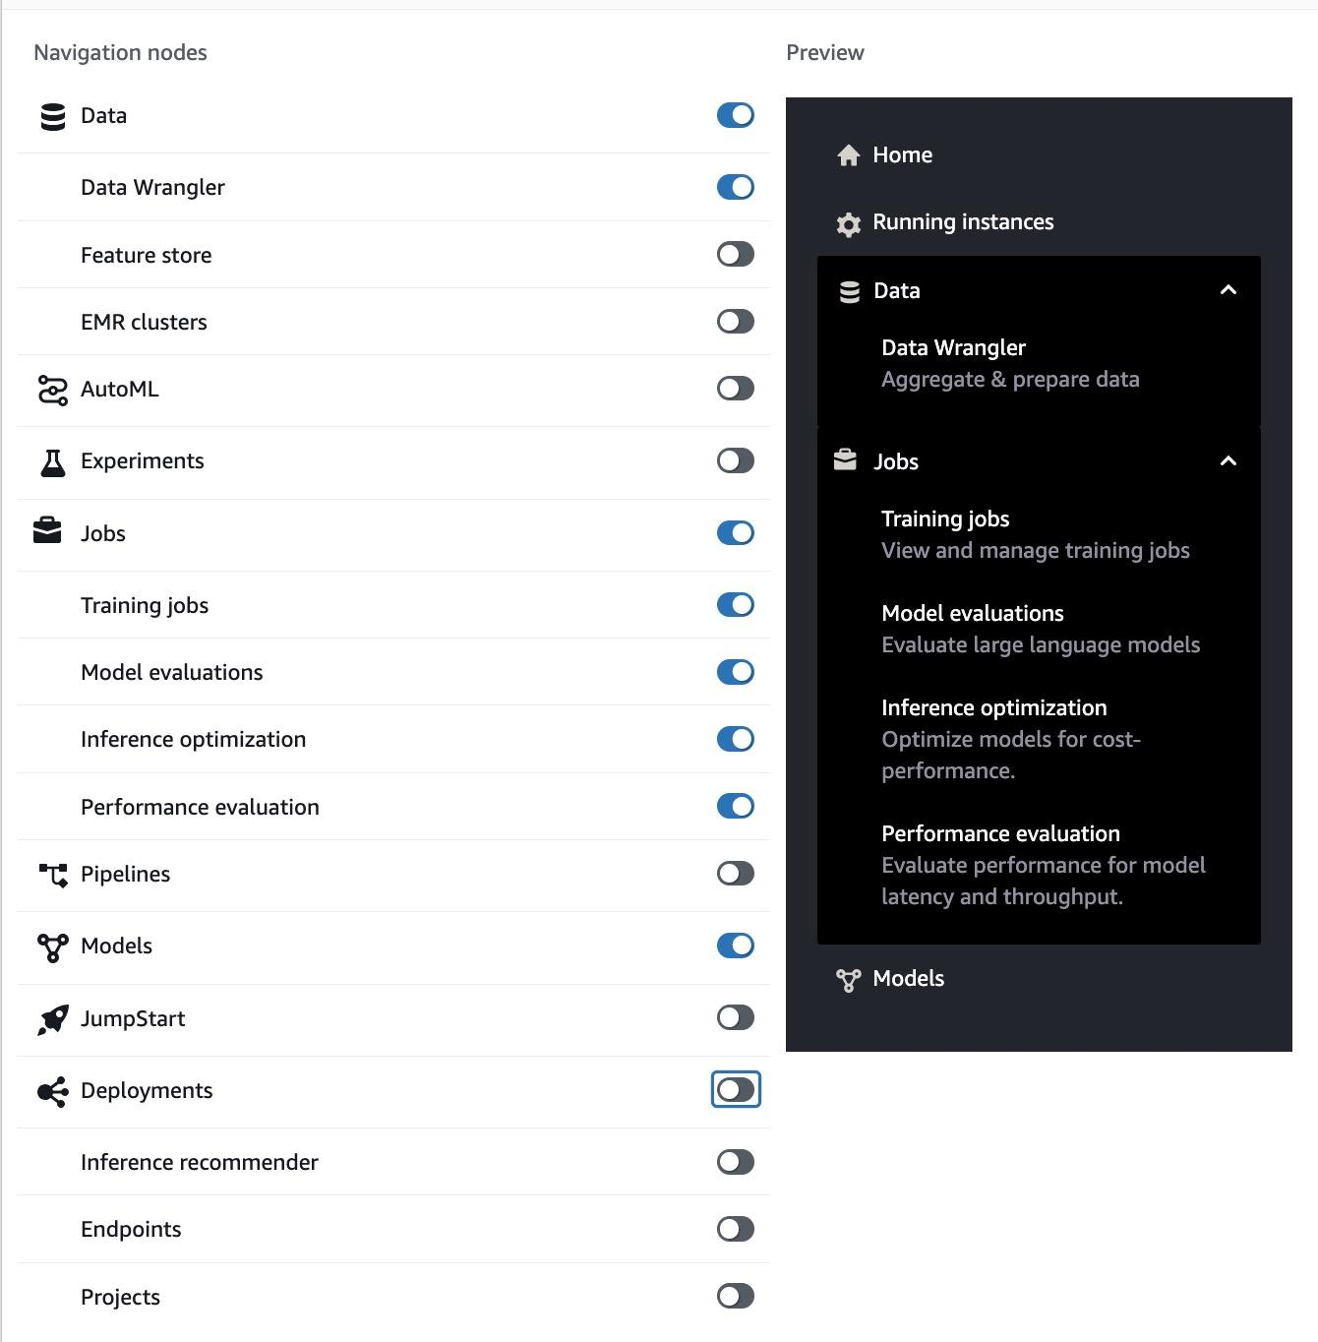
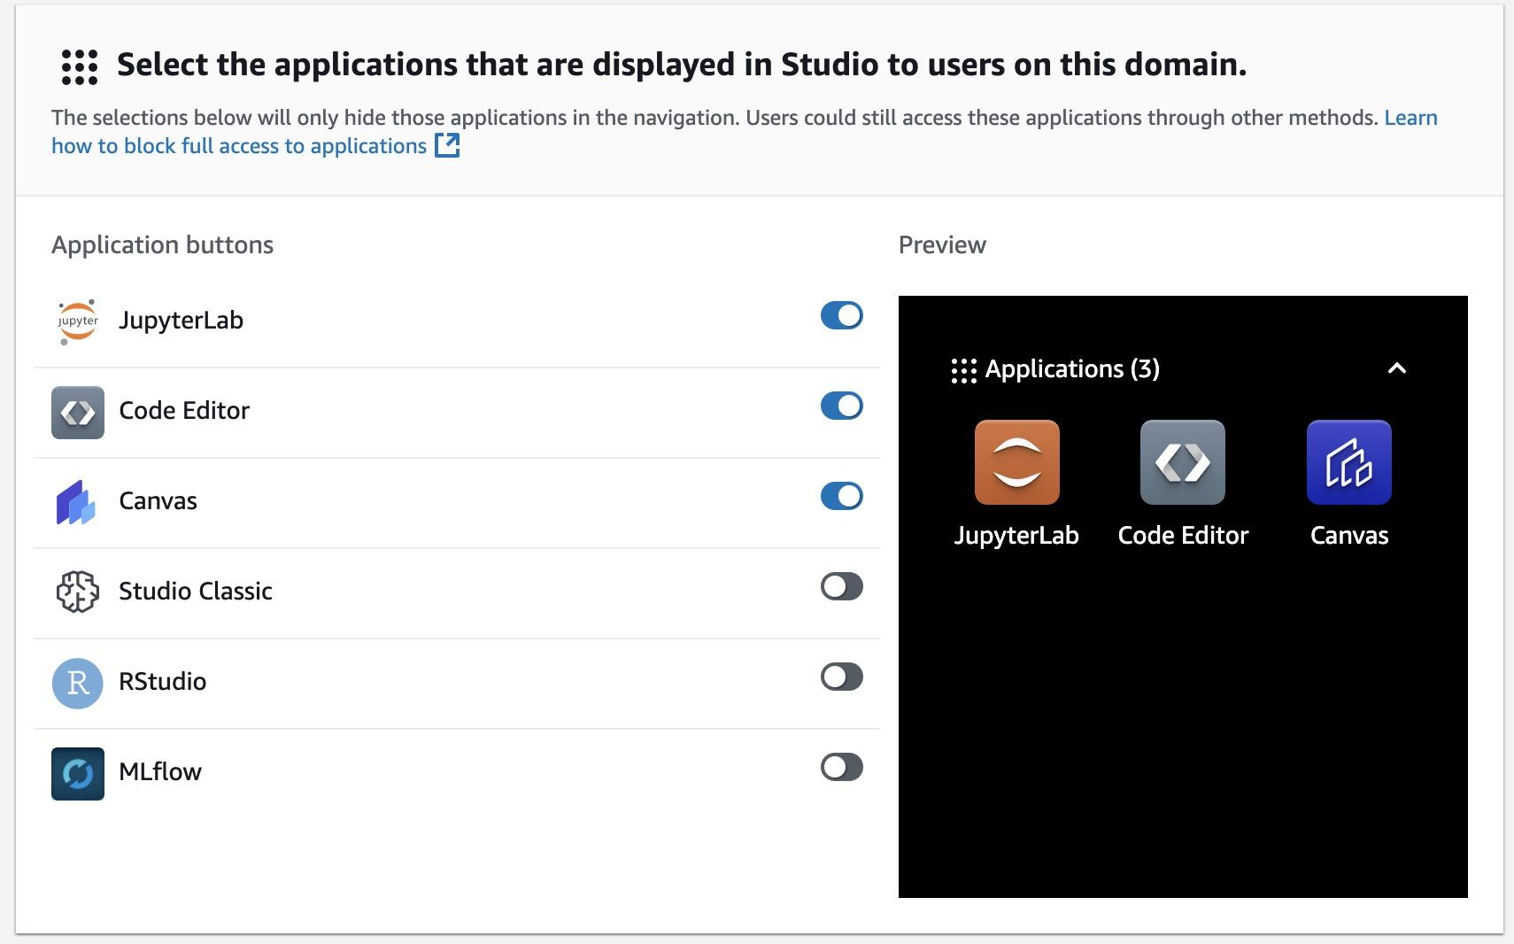
Domain Creation - AWS SageMaker

Slide 18
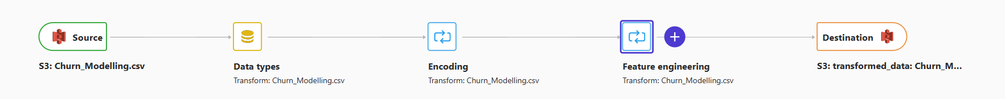
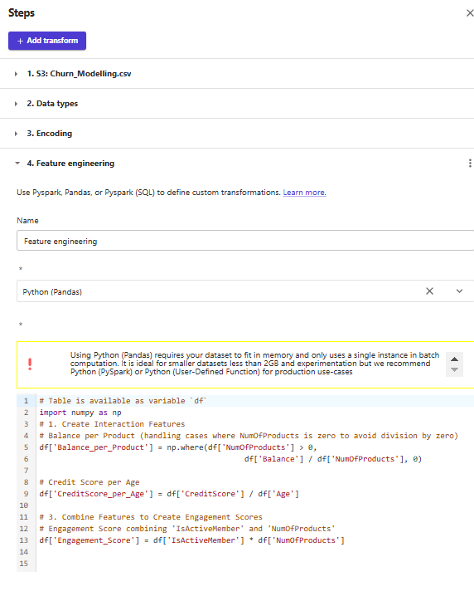
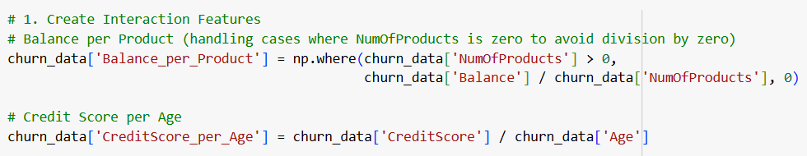
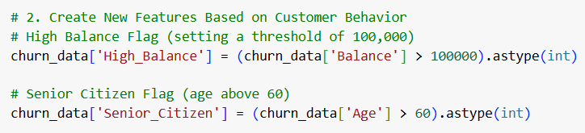
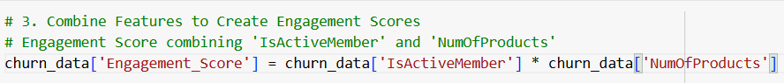
Featuring Engineering Code Block

Slide 19
Machine Learning Modeling - AWS Sagemaker
Algorithms tested:
Logistic Regression
Support Vector Machine (SVM)
Decision Tree
Random Forest
K-Nearest Neighbors (KNN)
F1 score as evaluation metric
Highly imbalanced dataset
Customers retained (0): 7963 | Customers exited (1): 2037
Balances minimizing both false positives and false negatives
Combines precision and recall
Commonly used for evaluating binary/multi-class classification

Slide 20
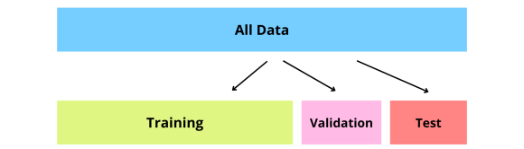
Machine Learning Modeling - AWS Sagermaker (cont.)
Workflow
First: split dataset with 10k instances into 90% train, 10% test
Second: split train set into 80% train and 20% validation
Train: 7200 | Validation: 1800 | Test: 1000
Used the “stratify” parameter in train_test_split() to ensure equal balance of 0 and 1 labels in y_train, y_val, and y_test

Slide 21
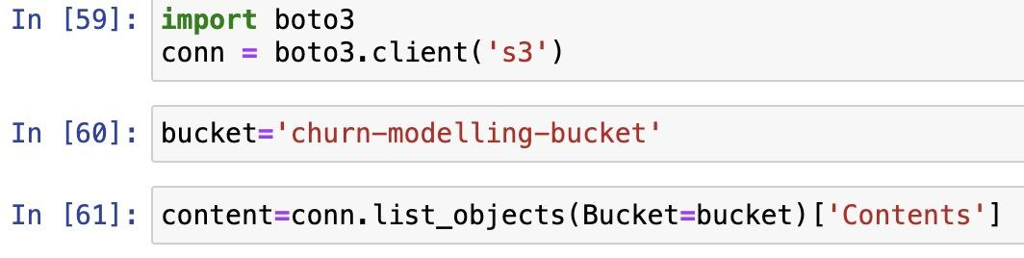
Machine Learning Modeling - AWS Sagermaker (cont.)
Initialized AWS Sagemaker Notebook Instance
Connect to folder containing preprocessed data within our S3 bucket

Slide 22
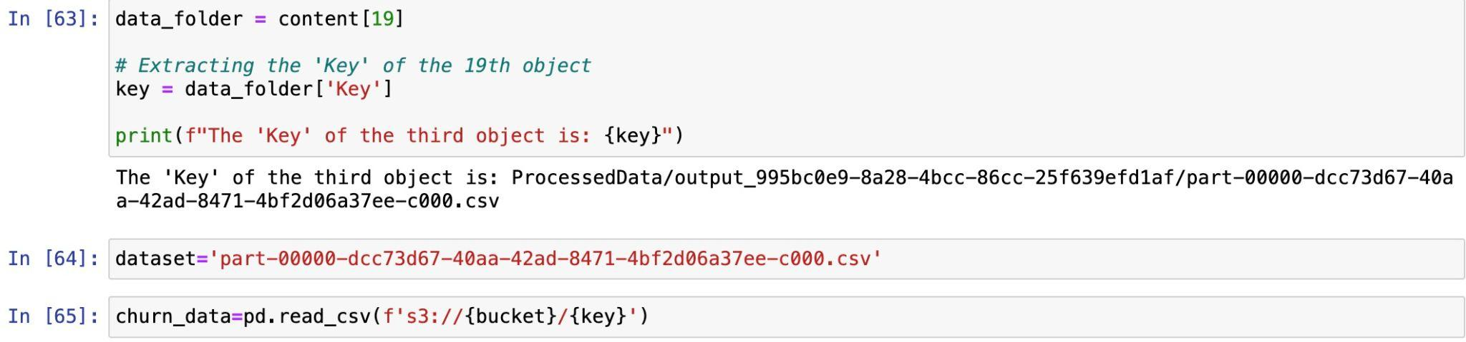
Machine Learning Modeling - AWS Sagermaker (cont.)
Putting the data into a dataframe

Slide 23
Machine Learning Modeling - AWS Sagermaker
Rest of the process was identical to using Jupyter/Colab
Results for the validation set are as follows:
Algorithm | F1 Score
Logistic Regression | 0.76
SVM | 0.82
KNN | 0.78
Decision Tree | 0.82
Random Forest | 0.83

Slide 24
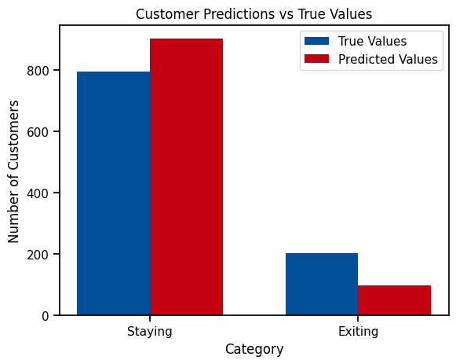
Machine Learning Modeling - AWS Sagermaker (cont.)
Used our trained random forest model to make predictions on the test set.
F1 score of our prediction is 0.82
Our model tended to overpredict customers staying and underpredict customers leaving.

Slide 25

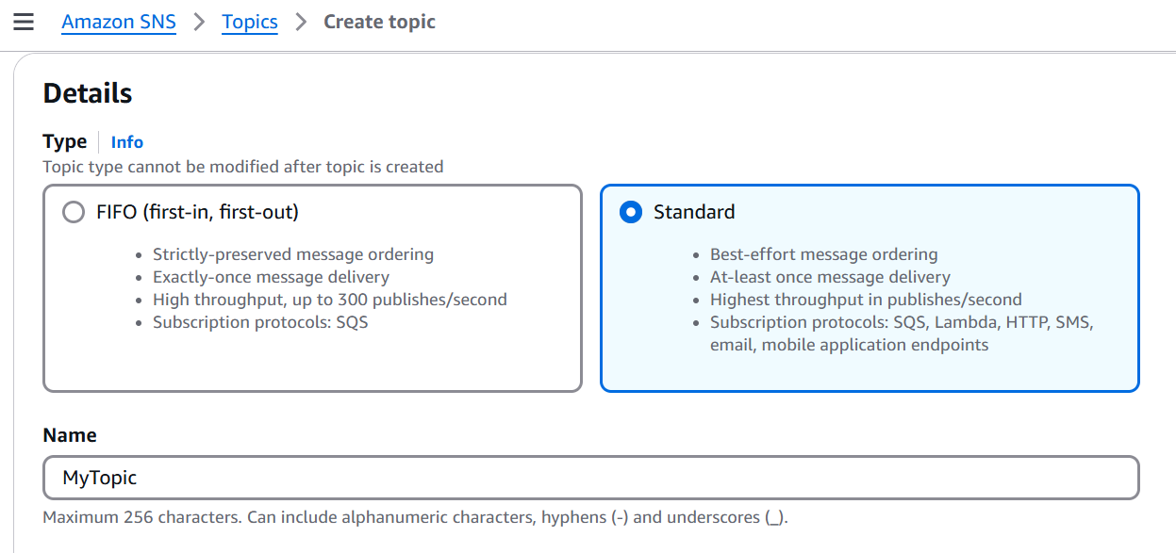
Event-driven Notifications - AWS SNS
Event Notification: SNS monitors the S3 bucket for updates
Trigger Lambda Function: Sends notifications for specific events like file uploads via SNS topic subscription.

Slide 26

Automating Custom Emails - AWS Lambda
File Retrieval from S3: Fetches required files (CSV and PDF) from the S3 bucket.
Email Composition: Processes email content and attaches files dynamically.
SES Integration: Uses SES to send emails to multiple recipients.

Slide 27

Delivering Emails - Amazon SES
Verified Senders: Uses SES-verified email addresses to ensure trusted delivery.
Email Sending: Sends transactional emails containing the updated files from the S3 bucket.
Attachments: Supports sending CSV and PDF files as email attachments.

Slide 28
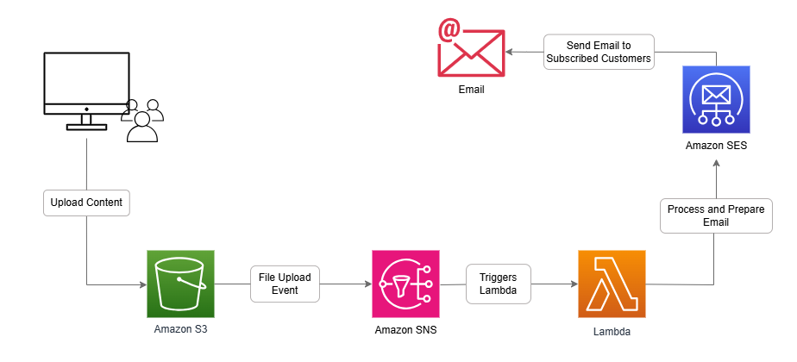
Notification Workflow with AWS Services

Slide 29
Data Visualization - AWS Quicksight
Tasks Performed:
Connected QuickSight to S3 data.
Objective: We are using Quicksight to identify factors influencing customer churn to inform retention strategies.
Key Metrics from the Analysis:
High balances reduce churn.
Seniors are more likely to leave.
Middle-aged customers have the highest balances.
Younger customers have higher engagement scores.
Churn varies significantly by balance levels.
Notes:
1. **High balances reduce churn**: Customers with higher account balances are less likely to exit, as financial stability and strong banking relationships often correlate with customer retention. This trend suggests that focusing on maintaining or increasing customer balances could effectively reduce churn.
2. **Seniors are more likely to leave**: Older customers, particularly senior citizens, exhibit a higher likelihood of exiting. This could be due to factors such as changing financial priorities, reduced need for certain banking products, or dissatisfaction with services targeted at this demographic.
3. **Middle-aged customers have the highest balances**: Customers in the 40-50 age group typically maintain the highest average balances, likely reflecting peak earning years and established financial habits. These customers may represent a valuable target for premium services and retention strategies.
4. **Younger customers have higher engagement scores**: Younger customers, often under 30, show higher engagement scores, possibly due to their preference for digital tools and frequent interactions. This highlights the importance of leveraging technology and innovative products to retain and attract this demographic.
5. **Churn varies significantly by balance levels**: The likelihood of churn differs greatly across balance levels, with low-balance customers showing a higher tendency to leave. This indicates that improving account management and offering targeted incentives for low-balance customers could help reduce churn rates.

Slide 30
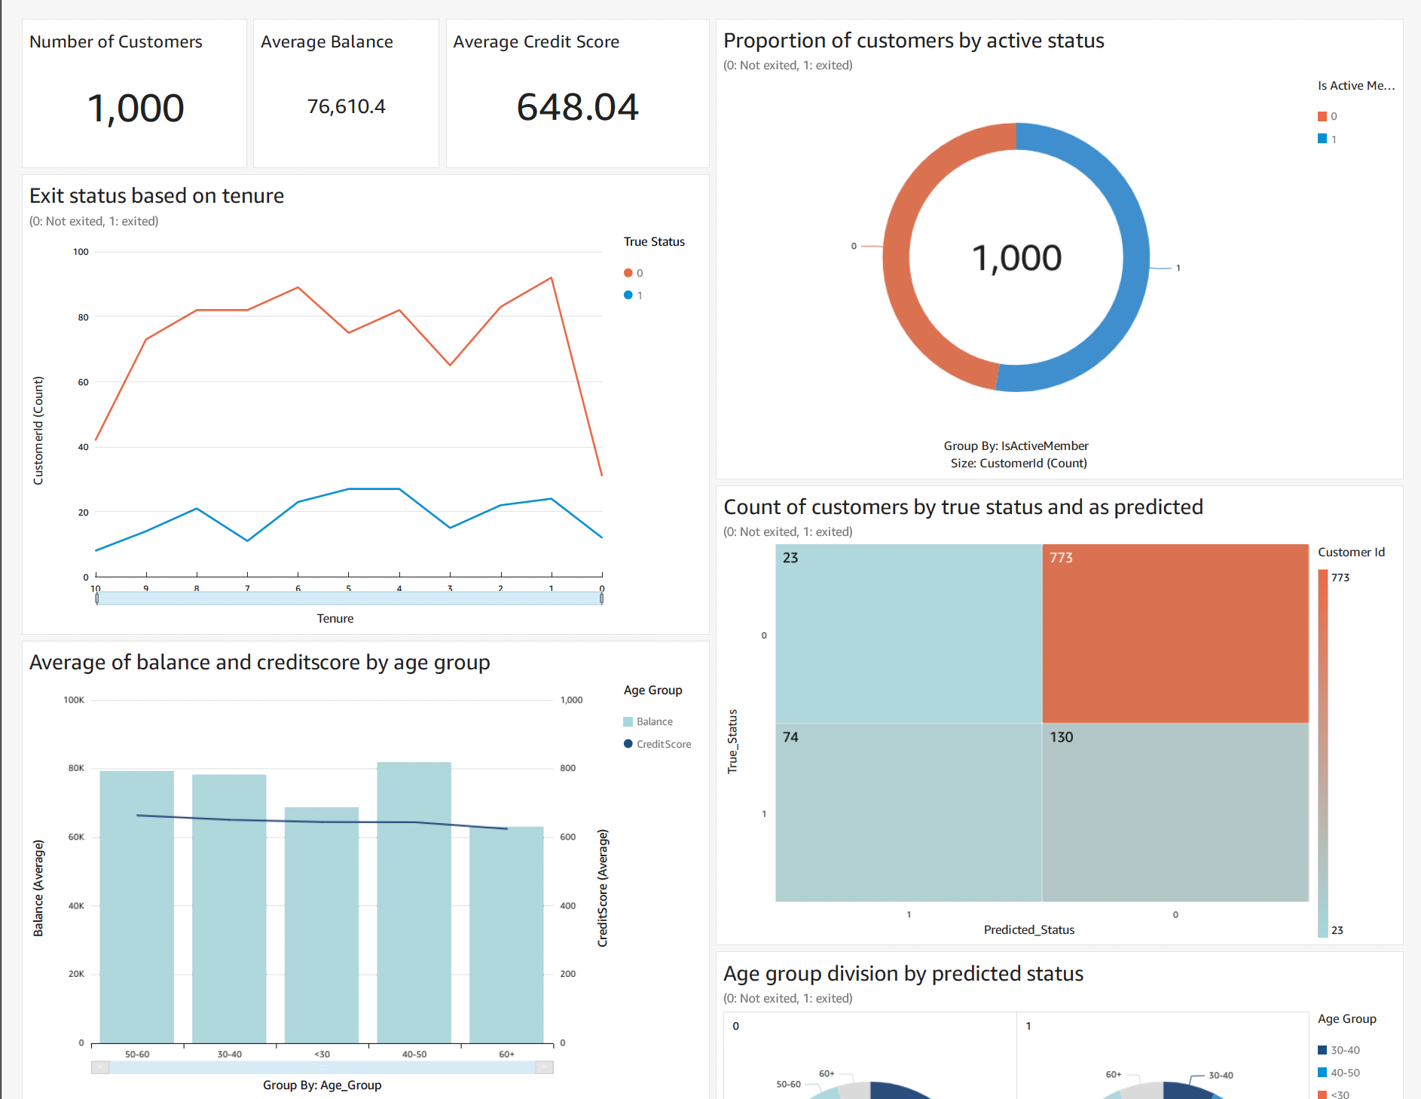
Quicksight

Slide 31
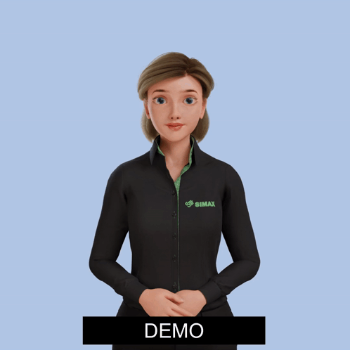
Live Demo!

Slide 32

Challenges and Resolutions
Custom IAM Policies: The predefined IAM policies did not meet the specific requirements of the project.
Solution: Designed and implemented custom inline policies tailored to the responsibilities.
AWS QuickSight Access Issue: Encountered a login issue while accessing QuickSight for the first time using an IAM user, even after providing all the required permissions.
Solution:Initial access to QuickSight must be set up to the root user.

Slide 33

Limitations and Future Scope
Limitations:
Very small dataset.
Requires additional real-time data.
Dataset may not reflect diverse industry-specific churn patterns.
Future Scope:
Integrate real-time predictions using AWS Lambda or Step Functions.
Extend to other business domains and datasets.
Experiment with deep learning models for improved accuracy.

Slide 34

Thank you!
Any Questions

